Slide 1
The Birmingham Tramways in the First World War
A talk by Douglas Smith MBE

Slide 2
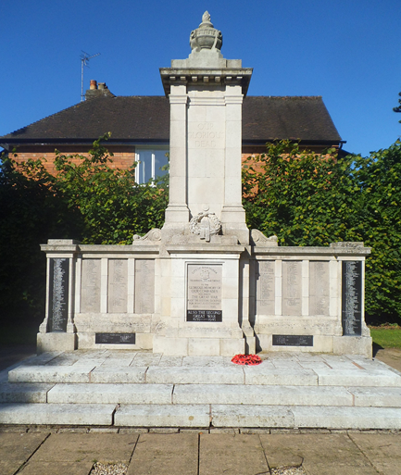
The Birmingham Tramways
Memorial

Slide 3
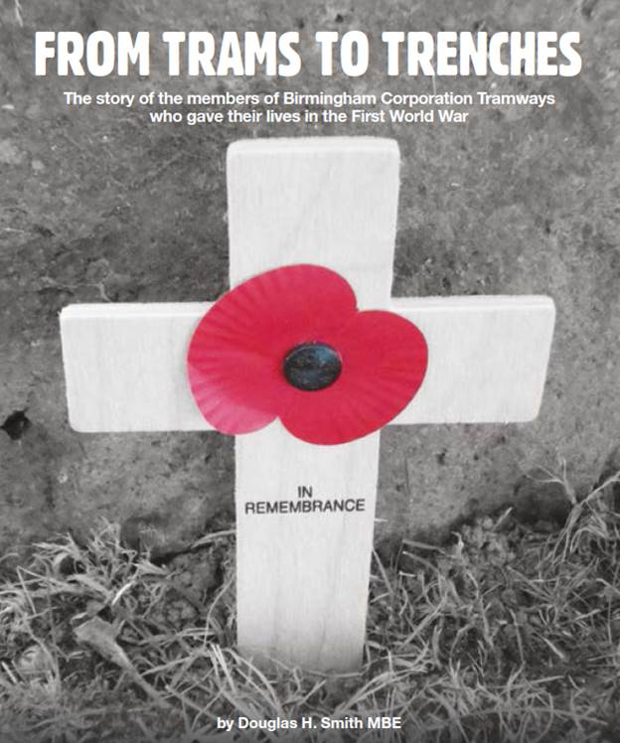
My Book

Slide 4
The Tramways Act 1870
Gave local authorities large measure of control over any tramways laid down in their districts.
1869 – Birmingham population – 360,000 but only 20 omnibuses.
May 1869 – Birmingham Omnibus Company was formed by William and Daniel Busby of Liverpool.
November 1869 – gave notice of their intention to promote a Birmingham Tramways Company. At the same time another syndicate, the Birmingham Street Tramways and there was a third scheme from Birmingham to Dudley Port.
October 1871 the Birmingham District Tramways Company Limited was formed to take over all three schemes

Slide 5
The new company set about construction of a 4ft 8 ½ in. gauge tramway and horse drawn tramcars began to operate on 20th May 1872.
Due to financial difficulties all the omnibus services had been discontinued by 1876 and a new company, the Birmingham Tramways and Omnibus Company Limited was formed.
In the late 1870s steam began to come into use as a motive power on tramways and in 1882 a new line with a 3ft 6 ins. gauge using steam power was opened.
In December 1882 the Birmingham Central Tramways Company Limited was formed to operate two groups of routes, one in the northern end and the other in the southern end of the city. With the exception of one line which was horse operated, steam traction was used.

Slide 6
All the lines within the borough, the narrow gauge 3ft 6 ins., were built by the Corporation and leased to the Company for 21 years.
By 1885 all the lines had been converted to this gauge. Also Cable was used for the first time.
1896 the City of Birmingham Tramways Company Limited was formed. This favoured converting the whole system to overhead electric traction but the Corporation favoured an underground conduit system.
1903 Birmingham Corporation obtained permission to operate its own tramways with Alfred Baker as its first General Manager.
By the end of 1906 the last steam tram was withdrawn and by 1911 the Corporation was the sole provider of trams in the city.
The first motor bus service was opened on 19 July 1913 and general powers to operate buses within the city was obtained in the Birmingham Corporation Act of 1914.

Slide 7
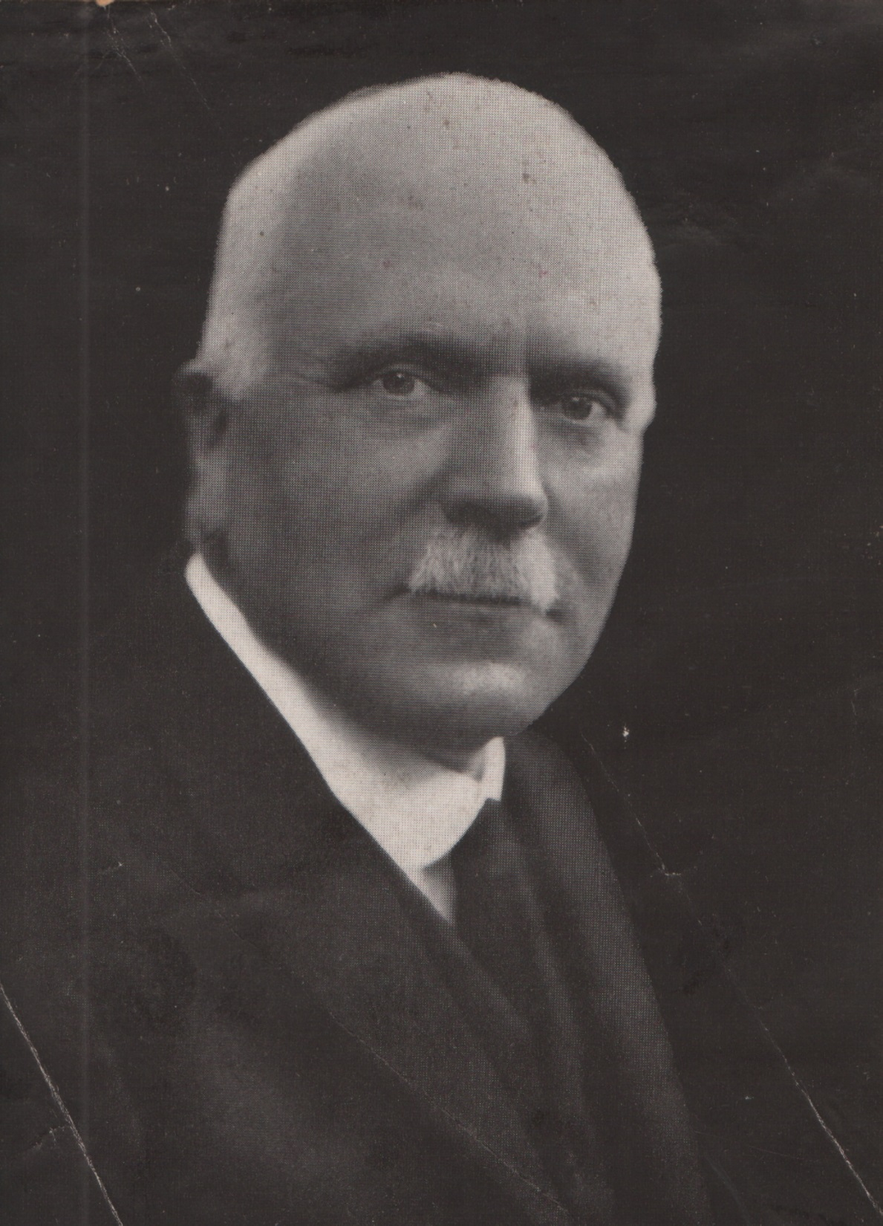
Alfred Baker, General Manager of Birmingham Corporation Tramways

Slide 8
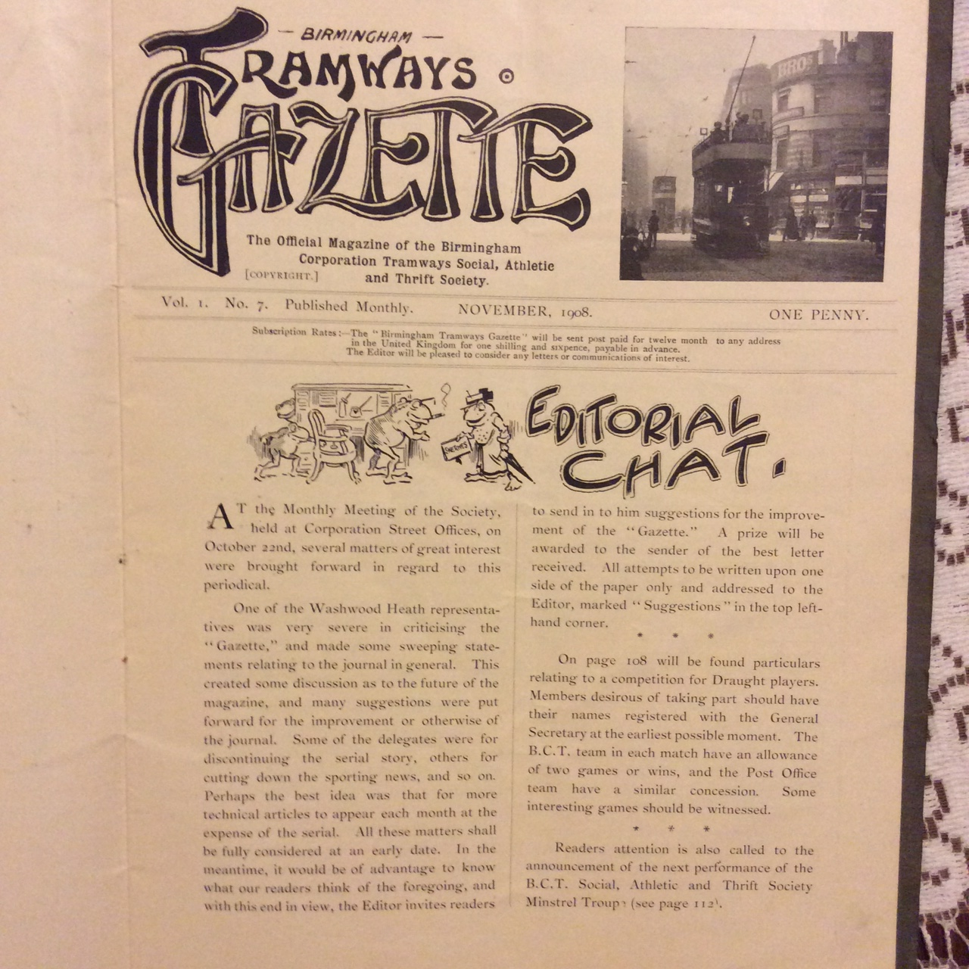

Slide 9
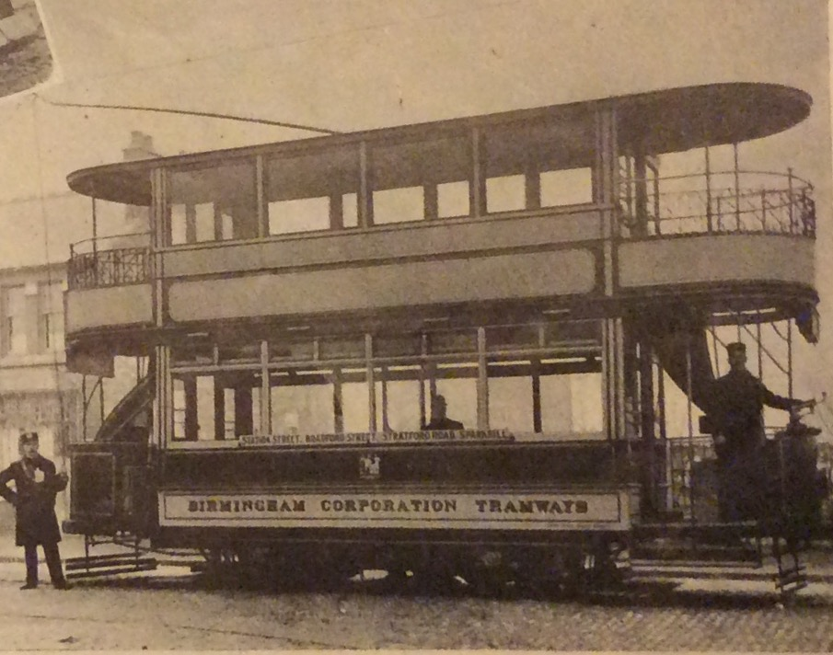

Slide 10
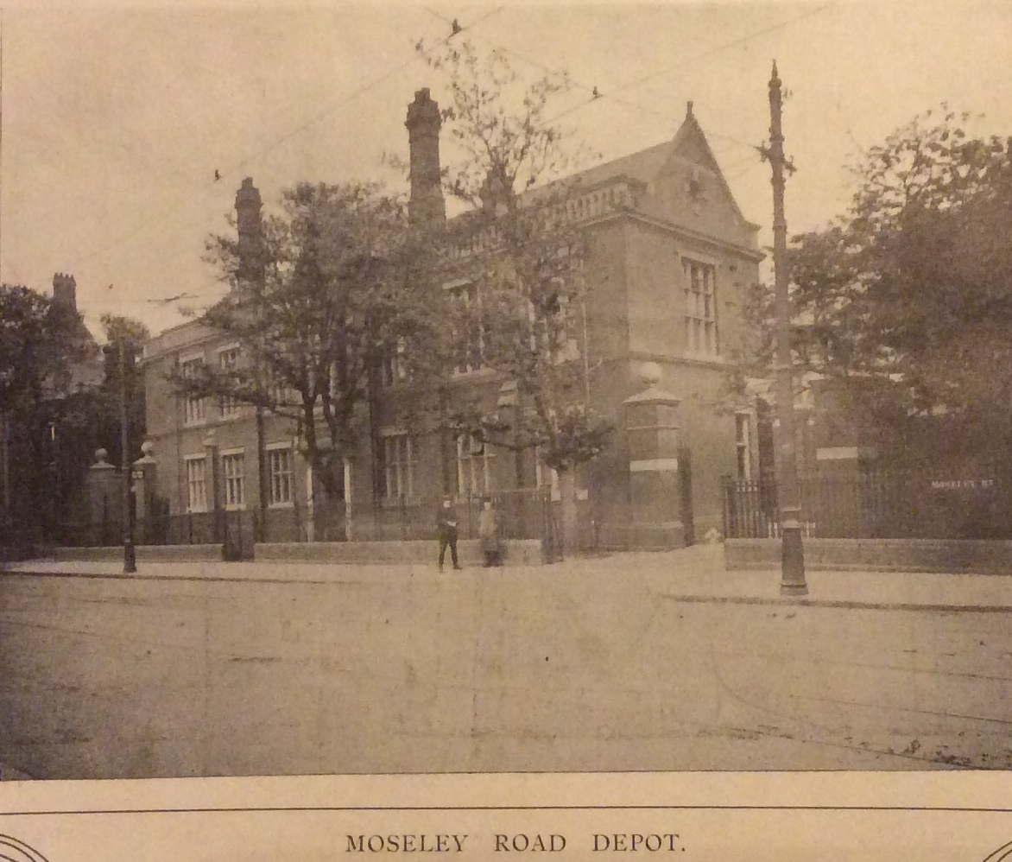

Slide 11
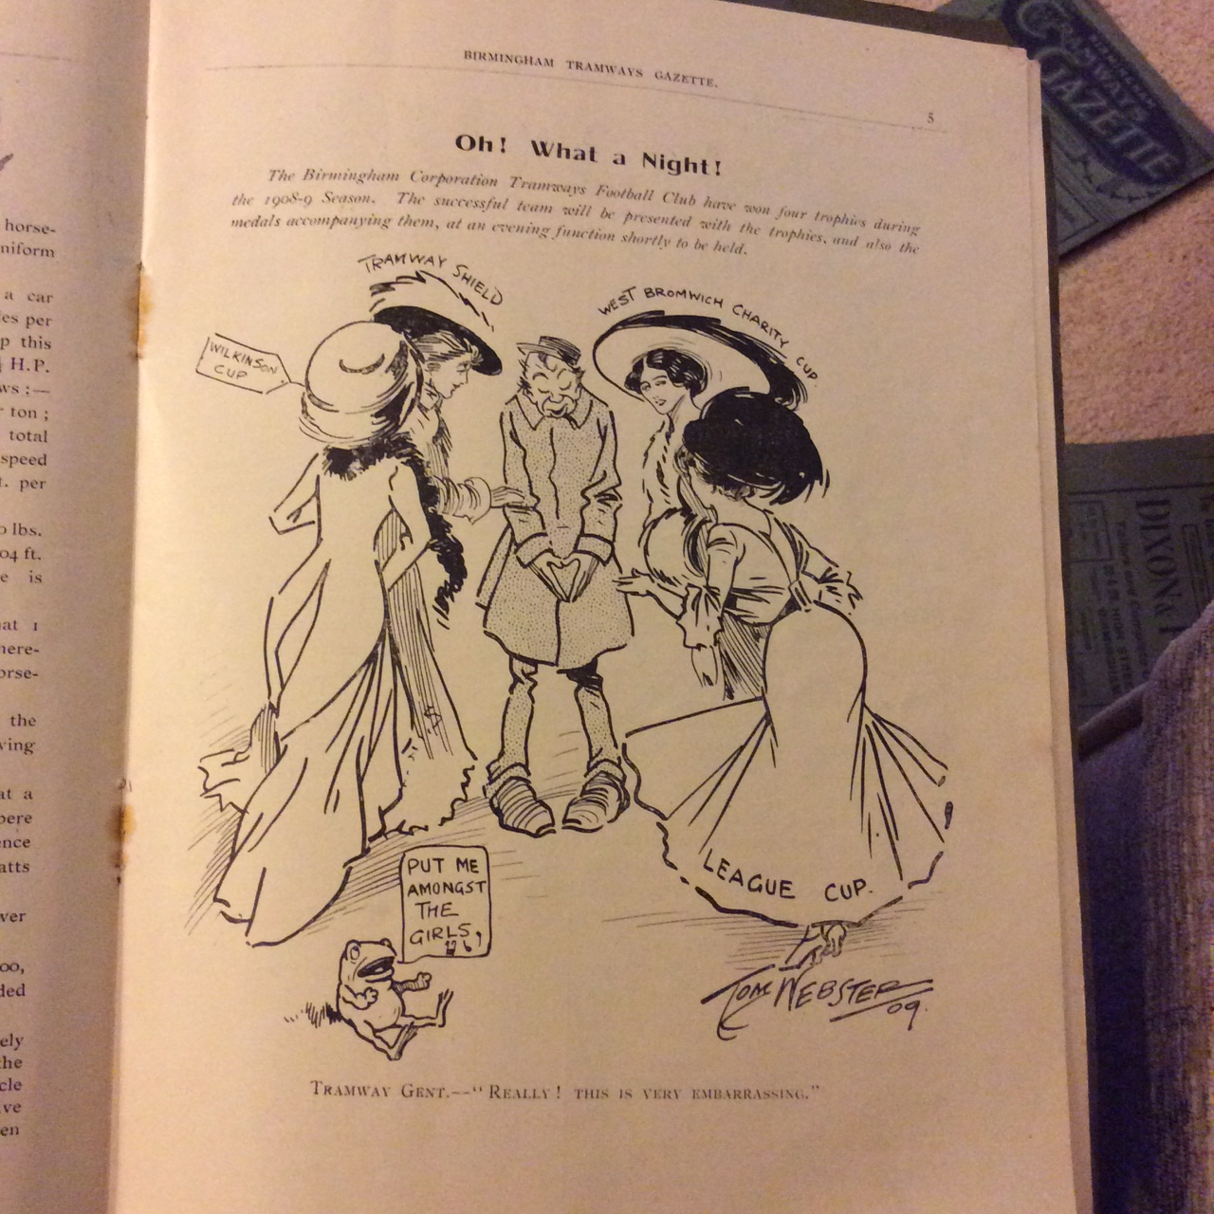
Oh What a night!
“The Birmingham Corporation Tramways Football Club have won four trophies during the 1908-09 season. The successful team will be presented with the trophies and also the medals accompanying them, at an evening function shortly to be held.”

Slide 12
The beginning of the war
The bank holiday weekend of August 1914 had been long anticipated. Up until then the weather had been changeable, sunshine and showers, but the weekend promised fine weather. Those could afford a holiday would make their way to New Street or Snow Hill Stations. Extra trains had been laid on for the huge exodus to the seaside resorts of North Devon and North Wales.

Slide 13
Many Brummies could not afford the luxury of a holiday and the prospect of half a day on a Saturday, the Sunday and a Bank Holiday Monday were havens of pleasure in their busy working lives. When the last tram had gone to its depot ‘Scrubbers Cars’, with water tanks and grinding stones, would passed along the tracks ensuring that they were smooth for the many journeys. Then, on the Bank Holiday Monday, the trams would be packed with countless thousands of Birmingham families making way to the many parks across the city.

Slide 14
The calling up of reservists
Fine Rally To Colours – ‘At the meeting of the Birmingham Tramways Committee this week the secretary and manager (Mr Alfred Baker) reported that about 700 employees of the department were absent with the colours. The bulk of the men are Army Reserves, but the department is also well represented in the Territorial units and Lord Kitchener’s new army.
The tramway employees in all departments number about 3,500, and the percentage of the total staff now serving the King or about to join the colours with the City Battalions is 19.3%. The departments losses are as follows – Traffic Department 27½%; Works 10½%; Overhead 20%; Permanent Way 11%; Shedmen 9%; Head Office Staff 21%.’ Birmingham Weekly Mercury
4th August 1914
19th September 1914

Slide 15
DORA
It gave the government wide-ranging powers during the war period, such as the power to requisition buildings or land needed for the war effort, or to make regulations creating criminal offences.
DORA ushered in a variety of authoritarian social control mechanisms, such as censorship:
"No person shall by word of mouth or in writing spread reports likely to cause disaffection or alarm among any of His Majesty's forces or among the civilian population"

Slide 16
Goodbye to some of the buses
Buses were impressed for military use.
Birmingham Municipal Motor ‘Buses 6th October 1914
At a meeting of the Birmingham Tramway Committee this morning it was reported that the department took over the motor ‘bus service in the city at midnight on Saturday. The service comprises a fleet of 30 buses, 13 being of 30 h.p. and 17 of 40 h.p. The Department also acquired at the same time the garage in Tennant Street where there is accommodation for 80 vehicles.

Slide 17
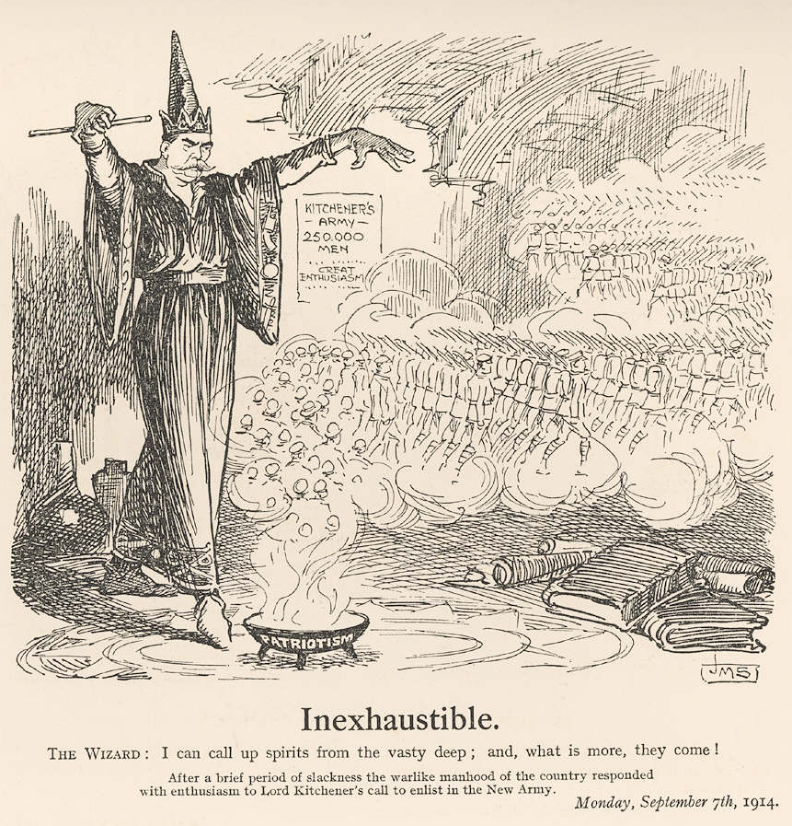
Kitchener’s appeal
On 5th August 1914, Minister for War, Field Marshal Earl Kitchener of Khartoum issued orders for the expansion of the army. On 6 August Parliament sanctioned an increase of 500,000 men of all ranks.

Slide 18
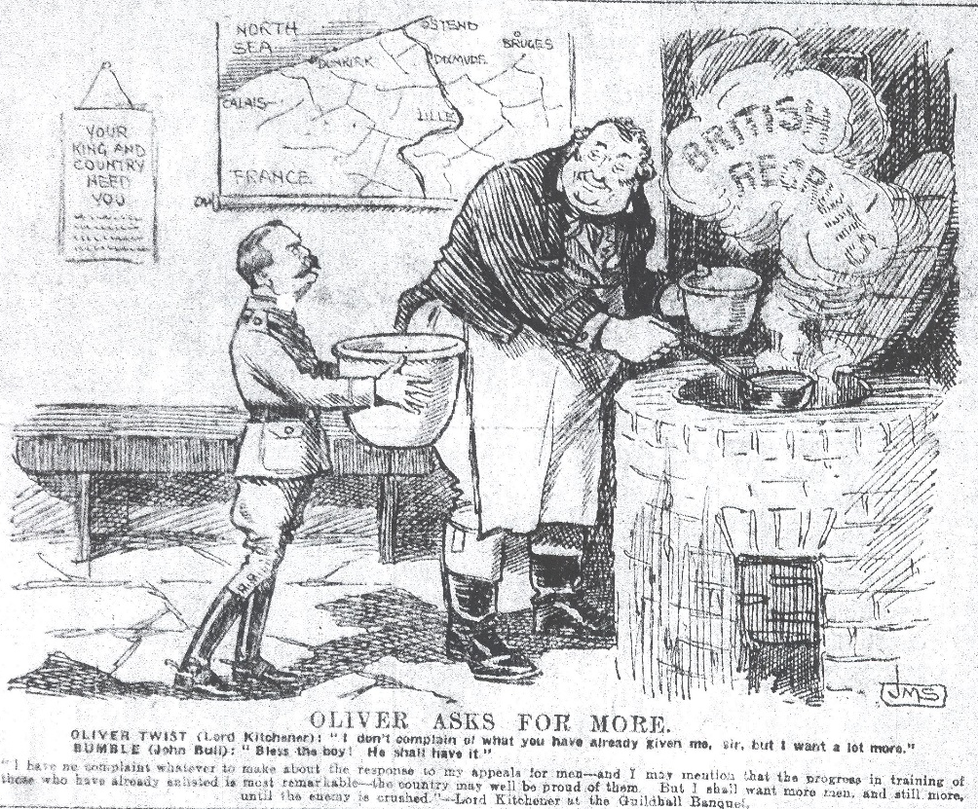
On 28th August 1914, Kitchener asked for another 100,000 men to volunteer. Army Order 382, issued on 11 September 1914, specified an additional six Divisions, which naturally would be called K2. They would be organised on the same basis as K1, and came under War Office control.

Slide 19
All over by Christmas 28th September 1914
“As we were coming away from St. Nazare the Officer told us that the war would all be over before Christmas. We had 500 German prisoners and 8 German officers on the boat we returned to England in. They were all glad to be captured, and their clothes and boots were not up to much. They were nearly worn out. One of the officers began to enquire how many we had on board. It is a good thing they did not know, as there were only 24 of us all told, and we should have looked a bit small if they had got up to any antics.
Private F. Goode (9475), who is also in the employ of the Birmingham Tramway Department is at present lying at Portsmouth General Hospital to which he has been invalided through illness. He is in the Royal Warwickshire regiment. Goode, who is well known in local football circles, has played Centre Half for several seasons in the Tramways football team, which has a place in the Birmingham Combination. Writing to a gentleman in Birmingham, he says:

Slide 20
Minutes book of the Central Committee of the Birmingham Corporation Tramways Social and Thrift Society 1914
18th September 1914 – It was resolved that the question of death allowance to ex-members called up to the colours be deferred until a specific case arises as the Department are dealing officially with all cases at present.
17th October 1914 – It was resolved that the Secretary forward £1 worth of cigarettes to 5 regiments at the front namely: Warwicks, Coldstreams, Worcesters, Royal Welsh Fusiliers and Royal Field Artillery.
20th November 1914 – It was resolved that members who have joined the Colours be not eligible to take part in Depot Competitions and that the Billiard match between Hockley and Moseley be replayed owing to Morton playing after enlisting.

Slide 21
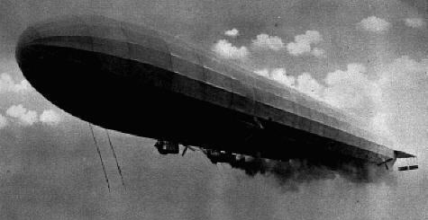
Zeppelin raids
The main campaign against England started in January 1915 using airships. From then until the end of World War I the German Navy and Army Air Services mounted over 50 bombing raids on the United Kingdom. These were generally referred to as "Zeppelin raids": although both Zeppelin and Schütte-Lanz airships were used. Airships made about 51 bombing raids on England during the war. These killed 557 and injured another 1,358 people. More than 5,000 bombs were dropped on towns across Britain, causing £1.5 million in damage. 84 airships took part, of which 30 were lost, either shot down or lost in accidents.[

Slide 22
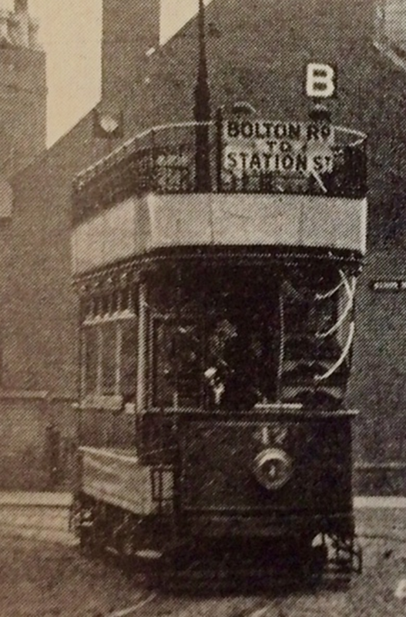
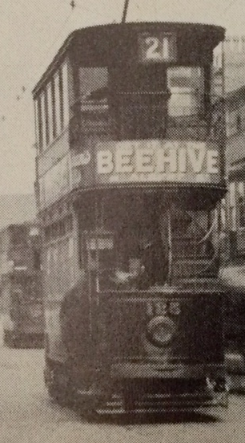
Route numbers
Reduced wartime lighting made it impossible for the destination boards and route letters to be seen at night so the route numbers were introduced and at first shown as black numbers printed on yellow material and placed over the headlamps.

Slide 23
Improvements to tram routes
6th January 1915
Despite the war, the Warwick Road tramway was completed and services started on 1916 02 02

Slide 24
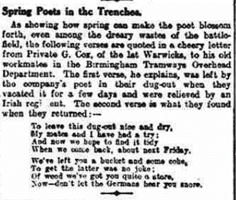
Spring poet in the trenches 3rd April 1915

Slide 25
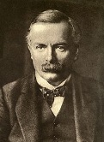
Ministry of Munitions
Following the Shell crisis, David Lloyd George was appointed Minister of Munitions on 25th May 1915 and he transformed the munitions industry so that, by July 1916, it was the largest buyer, seller and employer in the country.

Slide 26
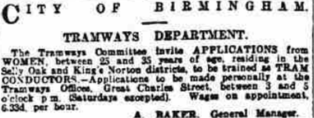
Demand for women conductors – 10th July 1915

Slide 27
The joys of women conductors – 28th August 1915
Car rides grow more and more interesting. The lady conductors are a huge success, and it is understood that Birmingham ‘Tommies’ when they return to civilian life will only vote for the return of men to the City Council who plump for a continuance and extension of the system. It is pleasant and encouraging to hear the sweet things calling , “Hurry up, please,” and” Hold tight”. Especially is that so when you are on the landing stage, and the conductor is in close proximity. I am sure that someone will respond affectionately to that “Hold tight!!!” request. But this lighter talk is merely by way of introduction to the serious thought. The other night one of the lady conductors was wearily complaining of a hard day’s work step-climbing: and no doubt even the masculine gender in the conductor line finds the moving too and fro exacting. This fact is evidenced by the habit which is growing up frequently to the annoyance of the passengers of demanding fares immediately on boarding the car. Now, there is no real need for this inside the penny stage area, because usually the conductor has to visit the top deck (and it is the top deck passenger I have in mind) to collect fares sooner or later: but it is a habit, and habits grow. The other morning I was third in boarding the tramcar within the penny stage and the male conductor asked for fares before we ascended, on the ‘’save me a journey” principal. The first man had to receive change: the second man had to fumble for his copper: churlish or not, an outside passenger hanging on while the car jolted, I declined to pay and made the conductor follow up, though the latter grumbled he had to come to the top three times after that and twice he collected fares. Obviously there is a remedy for this. And with the advent of the lady conductor, let us ask for reform on a limited scale, at least. Why not a kiosk at the termini at which tickets might be issued?...

Slide 28
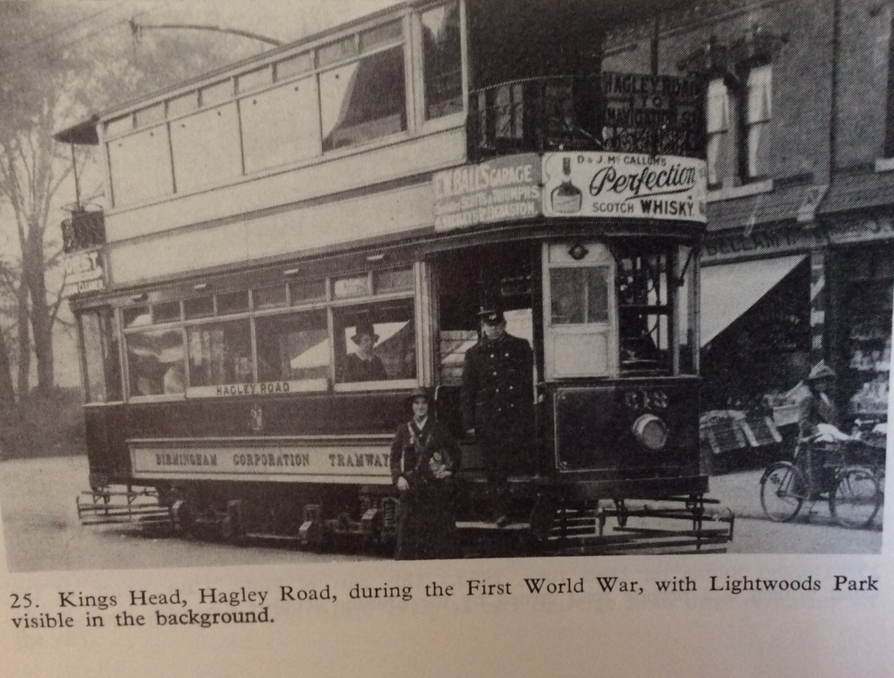

Slide 29
1915 Women tram cleaners
The Birmingham Tramways are following the lead of the railways and are employing women cleaners for the trams. There are about 50 women at work at the various depots.

Slide 30
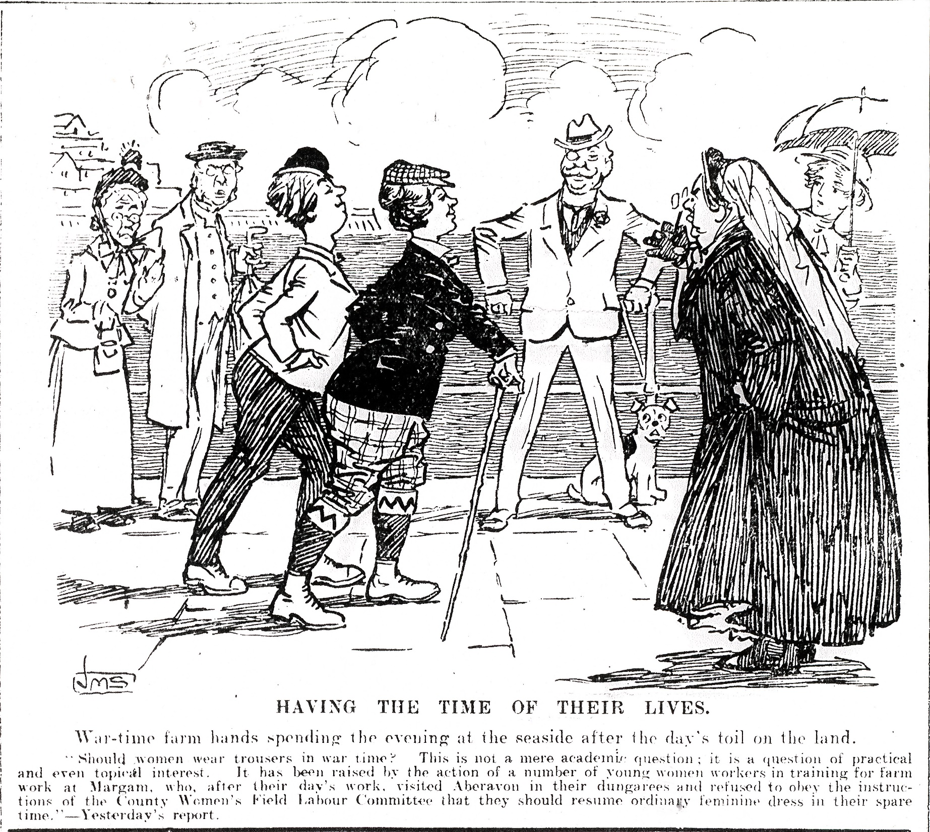
Women in trousers 6th September 1916
“Should women wear trousers in war time? This is not merely an academic question: it is a question of practical and even topical interest. It has been raised by the action of a number of young women workers in training for farm work at Margam who, after a day’s work visited Aberavon in their dungarees and refused to obey the instructions of the County Women’s Field Labour Committee that they should resume ordinary clothes in their spare time.”

Slide 31
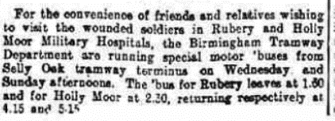
Extra buses – 11th September 1915

Slide 32
The Derby Scheme
The Derby Scheme was a scheme proposed by Lord Derby as an attempt to increase recruitment and avoid the need for conscription by allowing men to voluntarily attest for service at a later date. Men attested under the scheme would be paid 1 days wages, placed in the Class B army reserve and released to civilian life until needed by the military. The scheme was originally intended to run only from 16 October 1915 to 30 November 1915 , this was later extended to midnight of 11/12 December 1915.

Slide 33
Shortage of motormen. Call for volunteers to work the trams. Additional men or reduced services. 19th October 1915
7d an hour
Such is the shortage of motormen in the Birmingham Tramway Department that this morning the Tramway Committee decided to appeal to professional and businessmen, not eligible for military work, to act as drivers of trams.
Conveyance of munition workers
Special army recruiting campaign
No great physical strength was required to drive a tram…should be physically fit…(not subject to fits…

Slide 34
Tickets and bravery 19th October 1915

Slide 35
Avoidance? 22nd October 1915

Slide 36
Large influx of women workers. Serious question of lodgings 16th November 1915
At the present moment many agencies in the city are actively engaged in seeking lodgings for a large number of women who are expected to arrive in Birmingham shortly to find work in the local munition factories.

Slide 37
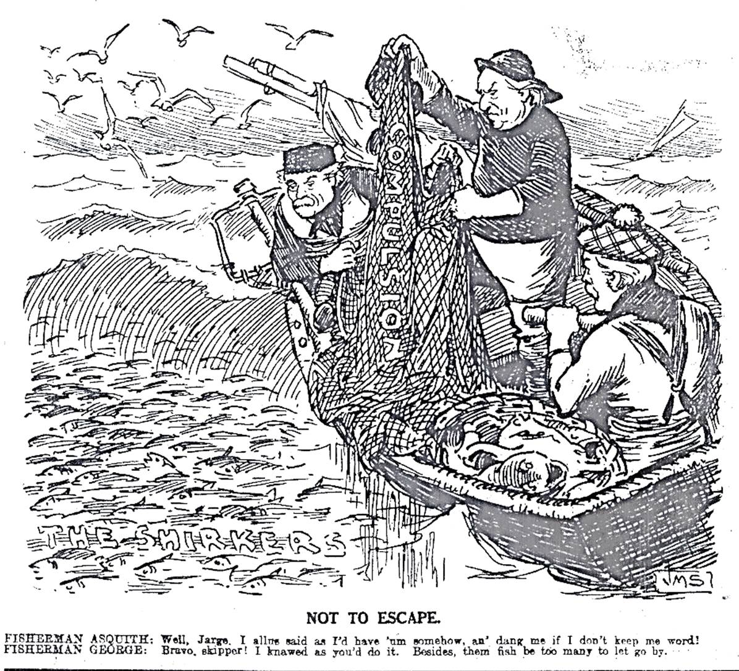

Slide 38
Minute book 1915
15th January 1915 – It was resolved that a tea and concert be arranged for the wives of our men who have joined the Colours, at the Moseley Depot at an early date.
19th February 1915 – It was resolved that another concert and tea be given at Moseley during March for soldiers wives as before.
16th April 1915 – Resolved that steps be taken to arrange parties for soldiers wives at the stadium during the summer
28th May 1915 – It was resolved that two tins of Hero Biscuits be forwarded to prisoners of war in Germany who are members of the Society prior to joining the Colours.
19th November 1915 - It was resolved that two tins of Hero Biscuits be forwarded to prisoners of war in Germany.

Slide 39
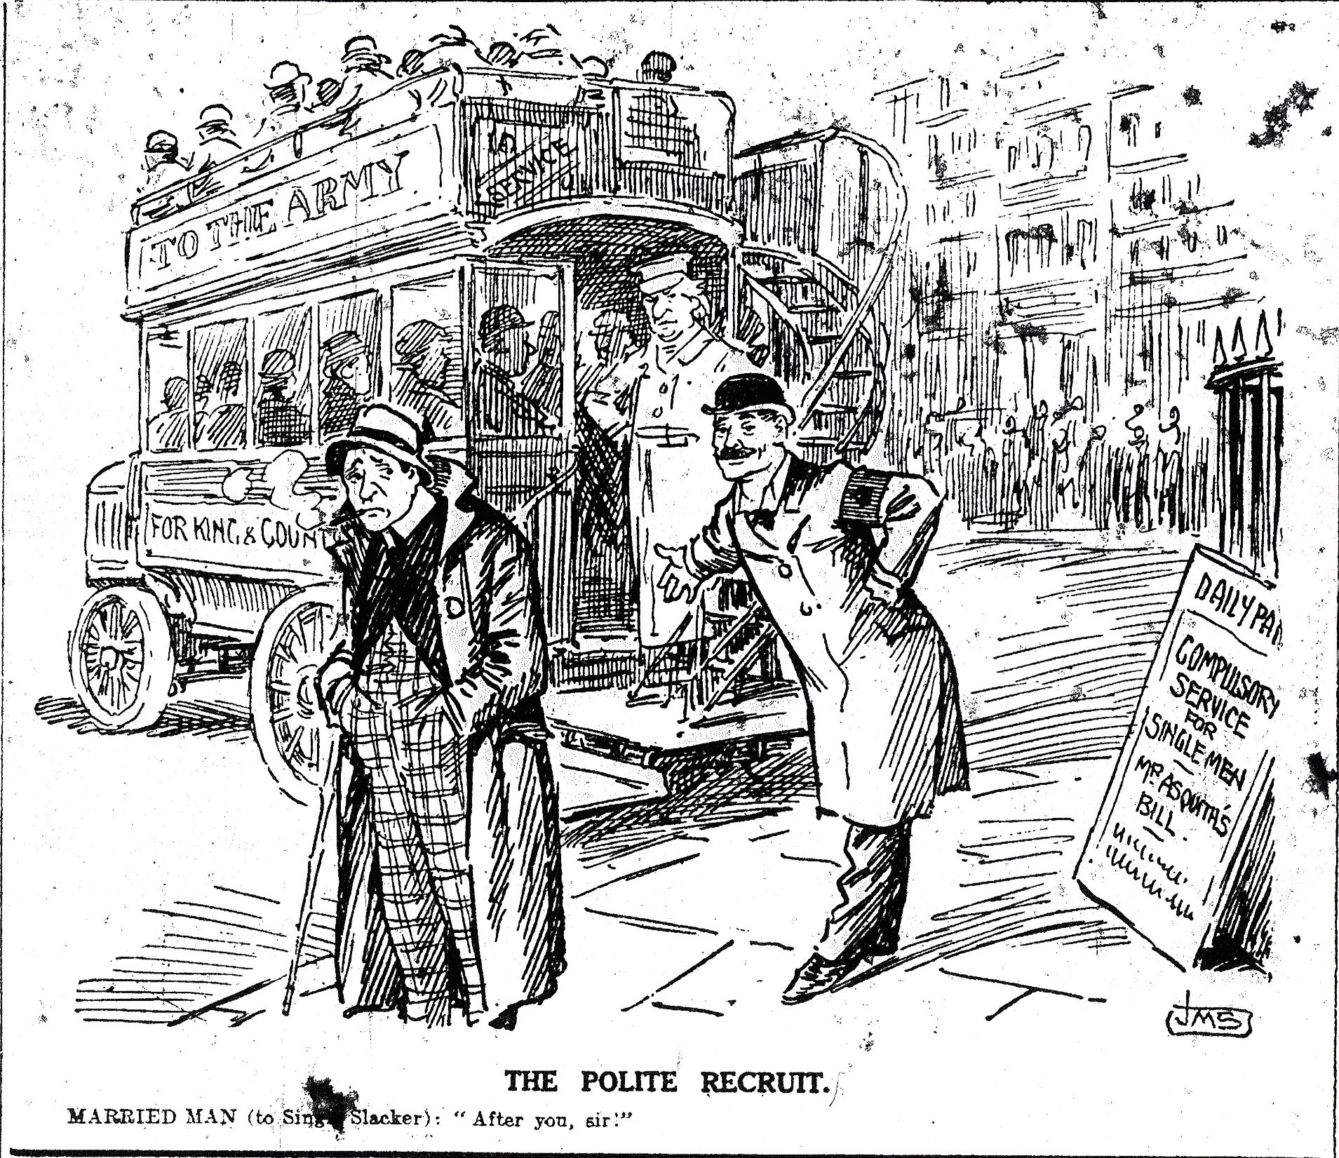
Conscription
In January 1916 the Military Service Act was passed. This imposed conscription on all single men aged between 18 and 41, but exempted the medically unfit, clergymen, teachers and certain classes of industrial worker.
A second Act passed in May 1916 extended conscription to married men.

Slide 40
Tram and bus profits 3rd June 1916
The Birmingham Tram Committee reports that during the quarter ended March 31st last it carried in its trams 163,258,684 passengers, who yielded receipts equalling £762,365. The motor ‘bus passengers was 6,301,324 yielding £47,865. The surplus profits of the department for the twelve months was £107.794, of which £50,000 was allocated to the relief of the rates.

Slide 41
Shortage of petrol 1st August 1916
The Birmingham Tramways Department, which has a powerful fleet of motor omnibuses, has received its supply licenses from the Petrol Commissioners. The normal supply is reduced by exactly one half. Mr Alfred Baker…pointed out that the Birmingham omnibuses were largely used in carrying munition workers to and from factories … if the supply were permanently lessened by 50% some of the services might be curtailed…experiments with paraffin as a petrol substitute… trials were successful … In the national interest the munition workers’ ‘bus services would be the last to be interfered with; and, in the event, the best would be done that was possible to prevent any disturbance of the suburban services.

Slide 42
Tram traffic in the darkened streets 16th September 1916
The darkness of the city streets at night and the consequent danger of accidents has been seriously engaging the attention of the British Tramway Department. The experience of drivers of the cars in the last month has been to demonstrate the need for more light on the cars, and representations have been made on the subject by the motor-men to the Tramway Committee.
The matter is one affecting the safety of the public, and the view of this fact the committee has approached the Watch Committee, asking that some modification may be made in regard to the regulations now in force as to the lighting of cars. If the Watch Committee agrees, it will be following the example set by Glasgow Corporation. If not, Councillor Harrison Barrow, chairman of the Tramway Committee, declared to-day that the question of stopping the tram services at an earlier hour every night will have to be considered.

Slide 43
Soldiers free tram rides but not Birmingham 15th October 1916
The Liverpool Corporation Tramways Committee have issued nearly nine million free passes to soldiers, representing an expenditure of £41, 308. In Birmingham the tramways department has not seen its way to granting free passes to all soldiers in the city. At the July meeting of the City Council a request was made that this should be done, but the chairman of the committee pointed out that to allow the men to travel on the trams indiscriminately would create difficulties. The department he explained, allowed all wounded soldiers and sailors who regularly attended the outpatient department free passes on that route.
Since July the committee had considered the matter, and Mr Baker, the manager, explained tis morning that the system now adopted is that free passes are placed at the disposal of the chief administrator of 1st Southern General Hospital, and he distributed them amongst the wounded soldiers in the hospitals of the city as he deems desirable. Mr Baker said that he could not give the total number of such passes issued, but it was certainly some thousands per week.

Slide 44
Interruptions in Tramway Traffic 15th November 1916
The people are respectively informed that owing to the heavy demands on the Electricity Supply Department by Munition Factories and others engaged in Government work, there is at certain periods of the day an insufficient supply of electric current for Tramway purposes. In consequence the Tramway services ARE LIABLE TO BE SUSPENDED daily further notice, as follows: viz: between
9.30 a.m. and 12.45 p.m.
2.30 p.m. and 5.45 p.m.
It is expected that the Services will be fully maintained on Saturdays and Sundays.
Alfred Baker, General Manager

Slide 45
Improvement yesterday in the Birmingham Trams 30th November 1916
The Birmingham Tramways Department yesterday almost succeeded in maintaining a continuous service throughout the day.
There was no breakdown during the morning, and all went well until four o’clock in the afternoon when the current failed on practically the whole of the routes.
Last night we were informed that no definite reply had been received from the Ministry of Munitions to the application of the Electric Supply Committee for permission to supply the necessary current to run a continuous but attenuated service.

Slide 46
Minute book 1916
3rd March 1916 - It was resolved that the sum of £20 should be forwarded to the Lady Mayoress for the purpose of providing Gramophones for the Tramway Companies of the Royal Warwicks (Territorial Force).
21st July 1916 – Secretary reported that the Band had recently given a Concert at the Southern Hospital for Soldiers at Bournbrook which had been greatly appreciated by the patients. The Secretary was again requested to draw attention to the War Savings Scheme both from the point of view of the necessity of the country and the value of the scheme to the members themselves. The scheme is as follows: 6 vouchers can be purchased from the Depot Inspector or Clerk and adhered to forms in the same manner as the Savings Bank 1d system, when 31 have been so obtained by any member they will be exchanged for an Excheques Bond value 15/9 after one year, 16/9 after two years, 17/9 after three years, 18/9 after four years and £1 after five years.

Slide 47
Unrestricted submarine warfare 1st February 1917
The British, with their overwhelming sea power, had established a naval blockade of Germany immediately on the outbreak of war in August 1914, and in early November 1914 declared it to be a War Zone, with any ships entering the North Sea doing so at their own risk.
The Germans had responded by launching submarine warfare against British shipping, attacking shipping in the seas around Britain. After the sinking of the Lusitania in May 1915 they had stopped because the fear of the USA entering the war against them.
By 1917 the British blockade was causing great problems in Germany. A report had said that resuming unrestricted submarine warfare again would cause Britain to sue for peace within six months and if the USA came into the war the defeat of Britain would deprive them of a base to launch attacks against the Germans, hence, on 1st February 1917 they began once again.

Slide 48
Combing out 15th October 1916
In Birmingham there have been innumerable instances recently of men of military age securing the protection of munition works, with the obvious object of avoiding service with the colours. Some men who had been de-certificated by a Government Department had found it comparatively easy to get a badge and certificate in controlled and other works and many cases, too, might be quoted where men who had appeals against military service pending had escaped such responsibility by obtaining a position in a munitions factory. There were examples of men who, having been refused exemption by tribunal, had secured a war work badge and certificate when they had been called up.

Slide 49
Tramways in connection with munition works are of primary importance 20th February 1917
Men over military age at present disengaged or employed in non essential trades can be taught the duties of a tramway driver if they will upon becoming efficient take the places of motormen called to the colours. Apply personally at the Traffic Department, Great Charles Street, between 1.30 and 7.30 p.m. Monday, Tuesdays and Fridays.

Slide 50
Frost every night and snow nearly day 12th April 1917
The wintry weather has been a most unwelcome visitant this Eastertide, especially to those who have allowed their coal stocks to become depleted, and to the many who are anxious to get to work on their allotments.
A Birmingham weather expert has experienced nothing to approach it during the twenty five years he has been taking records and it is even asserted that there has been no parallel of so vigorous an extension of weather for more than 800 years.
So far as the month of April has gone, there have been twelve nights, including that of March 31st to April 1st on which there has been frost in the air. Since the beginning of October there has only been one month where frost was so persistent during the first twelve nights, and that was during the very severe weather in February…. During this month there has been snow on nine of the twelve days.

Slide 51
Tram conductresses’ dislike of late hours 12th April 1917
A tram conductress in the employ of the Birmingham Corporation Tramways Department applied to the Munitions Tribunal to-day on the ground that she did not like the late hours, and wishes to return to her former employment of making soldiers’ equipment.
Professor Tillyard: “There are not going to be any more dark nights. We have got the Summer Time Act now.”
Applicant persisted in her statement that the dark nights did not suit her.
Professor Tillyard: “I am afraid we cannot help you. You might try and select moonlight nights for your late turn.”

Slide 52
Record holiday traffic 23rd May 1917
In the absence of extra train facilities this Whitsuntide for getting away to the seaside, Birmingham folk made full use of the tram and motor ‘bus services in order to spend a few hours relaxation within easy distance of their homes. The holiday traffic of the Birmingham Corporation Tramways Department on Saturday and Monday constituted a record. On the Saturday 700,000 passengers were carried on the tramways, whilst 25,000 were conveyed to various destinations on the motor ‘buses. The rain on Sunday had the natural effect of causing many people to stay at home, though there were 320,000 tram and 12,000 ‘bus passengers during the day. The fine weather of Monday again had its effects on the figures for a Bank Holiday, no fewer than 800,000 passengers being carried in the trams and 65,000 on the ‘buses. The tram receipts on Saturday were £3,500, and on Monday £4,000.

Slide 53
Tram car joy rides 22nd September 1917
The little folk of Birmingham have found a new way of spending their Saturday pence: they patronise the tramcars. Travelling last Saturday morning on a car to one of our working class districts, I noticed a large proportion of children on the cars, and my curiosity being aroused, carefully noted that whilst many dismounted at the fixed stages, their places were rapidly taken by others, which confirmed me in the opinion that they were not making their way to some park or playground, but were merely having a joy ride. Speaking to the conductress on the subject, learnt that it was quite an ordinary Saturday occurrence. “They travel by the hundreds just for the sake of a ride,” she said, and added that she had almost run out of children’s tickets. Their happy shouts of laughter showed that they enjoyed the rides. The absence of the old-fashioned merry-go-rounds and the scanty quantity of sweets that a copper will now purchase are the causes that have probably contributed to the popularity of tram-riding as a juvenile amusement.

Slide 54
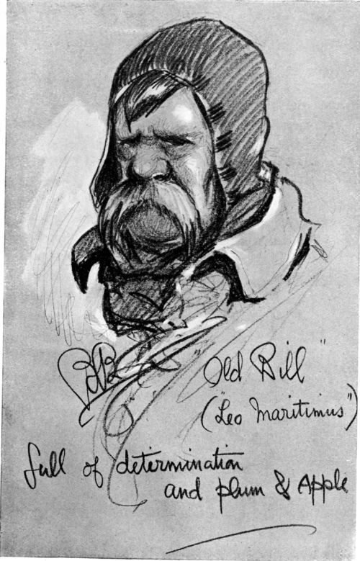
‘Old Bill’ Handsworth original of Bairnsfather Hero 1st October 1917
The “Weekly Dispatch” (London) claims to have established by means of a photograph the identity of the original of Captain Bairns father’s “Old Bill”, the hero of so many of his cartoons and the exemplification of the cheary spirit of the old British Army. “Old Bill”, who is said to have been photographed by Captain Bairnsfather in the trenches, was Acting-Inspector Patrick Rafferty, of the Birmingham Tramway Department, stationed on the Handsworth route.”

Slide 55
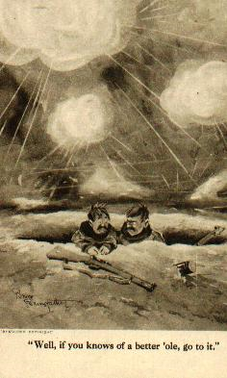
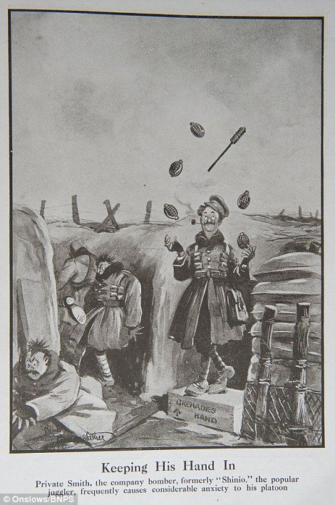
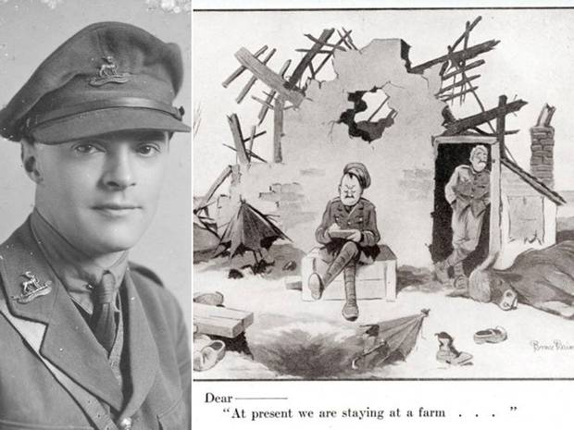

Slide 56
Tram lights 13th October 1917
A request has been made to the Tramways Department to erect 40 more overhead tramway trolley lights. It was hoped that these lights would be in use in a very short period. In making the survey the Chief Constable was guided by representations made to him by a deputation of tramway motor men who waited on him on 23rd August. The conditions for street traffic this year would be in every way better than during any winter since 1913-14. The tramcars had blinds pulled down last winter, but now permission was given for them to be raised, thus giving greater light around. Blue lights were being placed at the most important corners on all the main traffic routes.

Slide 57
Ex-soldier tram drivers 16th December 1917
The Watch Committee at their meeting yesterday endorsed the action of the Judicial Sub-Committee in granting licenses to the Birmingham Tramways Department in respect of 40 motormen and 1 motor-omnibus drives, who, although suffering from some disability as a result of the war, have been medically certified fit for the work. Several of the men were licensed drivers before the war.

Slide 58
Minute book 1917
20th April 1917 – It was also resolved that no Childrens’ Summer Party be held this year this year owing to Food Controllers wishes.

Slide 59
Tramways for carriage of goods 22nd January 1918
Representatives of the heavy goods trade met at the Council House last evening, under the presidency of the Lord Mayor (Alderman Brooks), to consider further questions of the co-ordination of transport facilities in order to reduce the number of horses and mechanically-driven vehicles employed in Birmingham, having regard to the shortage of provender and petrol.
At the request of the Lord Mayor, Mr Baker (manager of the Birmingham Tramways Department) undertook to consider whether or not some scheme could be adopted for carrying goods on the tramways.

Slide 60
Minute book 15th February 1918
£2/2/0 to the holder of the war time allotment, which is considered to be the best from a utility point of view in each district (North, South, East and West) and £1/0/0 to the next best.

Slide 61
Birmingham Tramway Employees and the 12 ½ % bonus 5th March 1918
Recently the Birmingham Corporation workmen and the tramway employees applied for a bonus of 12 ½ per cent on earnings. The basis of the application was that such a bonus had been awarded to munition workers; and inasmuch as the bonus was made to Corporation electrical workers and other employees, it was asked that uniformity of payment in this respect should be adopted…the refusal to grant the 12 ½ per cent bonus…would cause great disappointment, and possibly lead to trouble…It is unlikely that the dispute between employers and the ‘bus and tramway workers will give rise to any serious trouble – either in Birmingham or in the adjacent areas…no notice has been sent in, and the only danger of a strike locally would be in the event of the workers deciding to come out in sympathy with their comrades in other places….

Slide 62
Preparing for a general tram strike – 9th March 1918
A joint meeting was held on Wednesday in London of the Tramway and Vehicle Workers’ Union with reference to the action to be taken on Saturday night respecting the demand for an advance of 20s a week on pre-war wages to tramway and omnibus workers. In the event of a failure of the negotiations arrangements were made for a strike throughout England, Scotland and Wales.

Slide 63
Higher tram fares 27th March 1918
The Birmingham Tramways Committee had under consideration this morning the question of the revision of tramway fares, in view of the recent award of 12 ½ % bonus to the motormen and other employees. The increase in the cost of running the cars suggests, it is stated, the need for the revision of fares and stages. By statute the Corporation is compelled to run a stage of two miles for a penny, and the committee will ask the Council to apply to the Board of Trade for sanction to reduce that limit. When that permission is granted the Tramway Committee will submit for the approval of the City Council a scheme for the establishment of shorter stages.

Slide 64
Effect of new curfew order 6th April 1918
In view of the earlier closing of the theatres and music halls, it is possible that the times of the last tram run in Birmingham will be half an hour earlier than at present. No decision has been come to by the Birmingham Corporation Tramways Committee, but the department is watching the effect of the new Order upon the night traffic. If, as may be expected, there is a falling off in the number of late passengers, the department will deal with the matter accordingly, and it may be that the last cars on the various routes will be 11 o’clock instead of 11.30 as at present.

Slide 65
Unequal hardships of the new tram tariff 4th May 1918
The new advanced scale of tramway passenger charges put into operation in Birmingham this week appears to entail some quite unnecessary hardships and injustices, which suggests that the tariff might well be adjusted without any loss of revenue to the tramway department. Thus it is pointed out by one correspondent that persons who travel from town to the old penny stage can do so for three half-pence less than those who travel to the same point from the outer end, which is surely an inequality which is quite uncalled for. But the most glaring hardships are inflicted upon the users of the intermediate stages. Thus, on the main Handsworth route, the only three half-pence fare is from Soho Station to the Colmore Row terminus. Whyis there no other intermediate fare from the New Inns to those great industrial centres, such as the jewellery quarter, which thousands of people have to use daily to get to and fro from their homes to their business?...Girl clerks, who get home for their mid-day meal, are penalised fourpence a day, which a serious matter for them, while their employers, who can afford to live out at Chester Road or Wylde Green, only have to pay another half penny per journey… the tendency of all (the changes)…seems to be to impose the chief burden upon the poorer passengers, while touching the wealthier patrons, among them the city councillors, as lightly as possible…

Slide 66
Minute book - 17th May 1918
It was resolved that the Baker Cricket Shield be put for competition amongst women members.

Slide 67
Men ask for further increase 19th August 1918
Independent of the 5s a week increase already met so far as the men are concerned in the 12 ½ % awarded by the Birmingham Corporation, in addition to the £1 a week on the pre-war rate of wages, a request has been made to the Birmingham Corporation Tramways Committee to put into operation, so far as the men are concerned, the recent award of 3s 6d a week made by the Committee on Production to the engineering and allied trades.

Slide 68
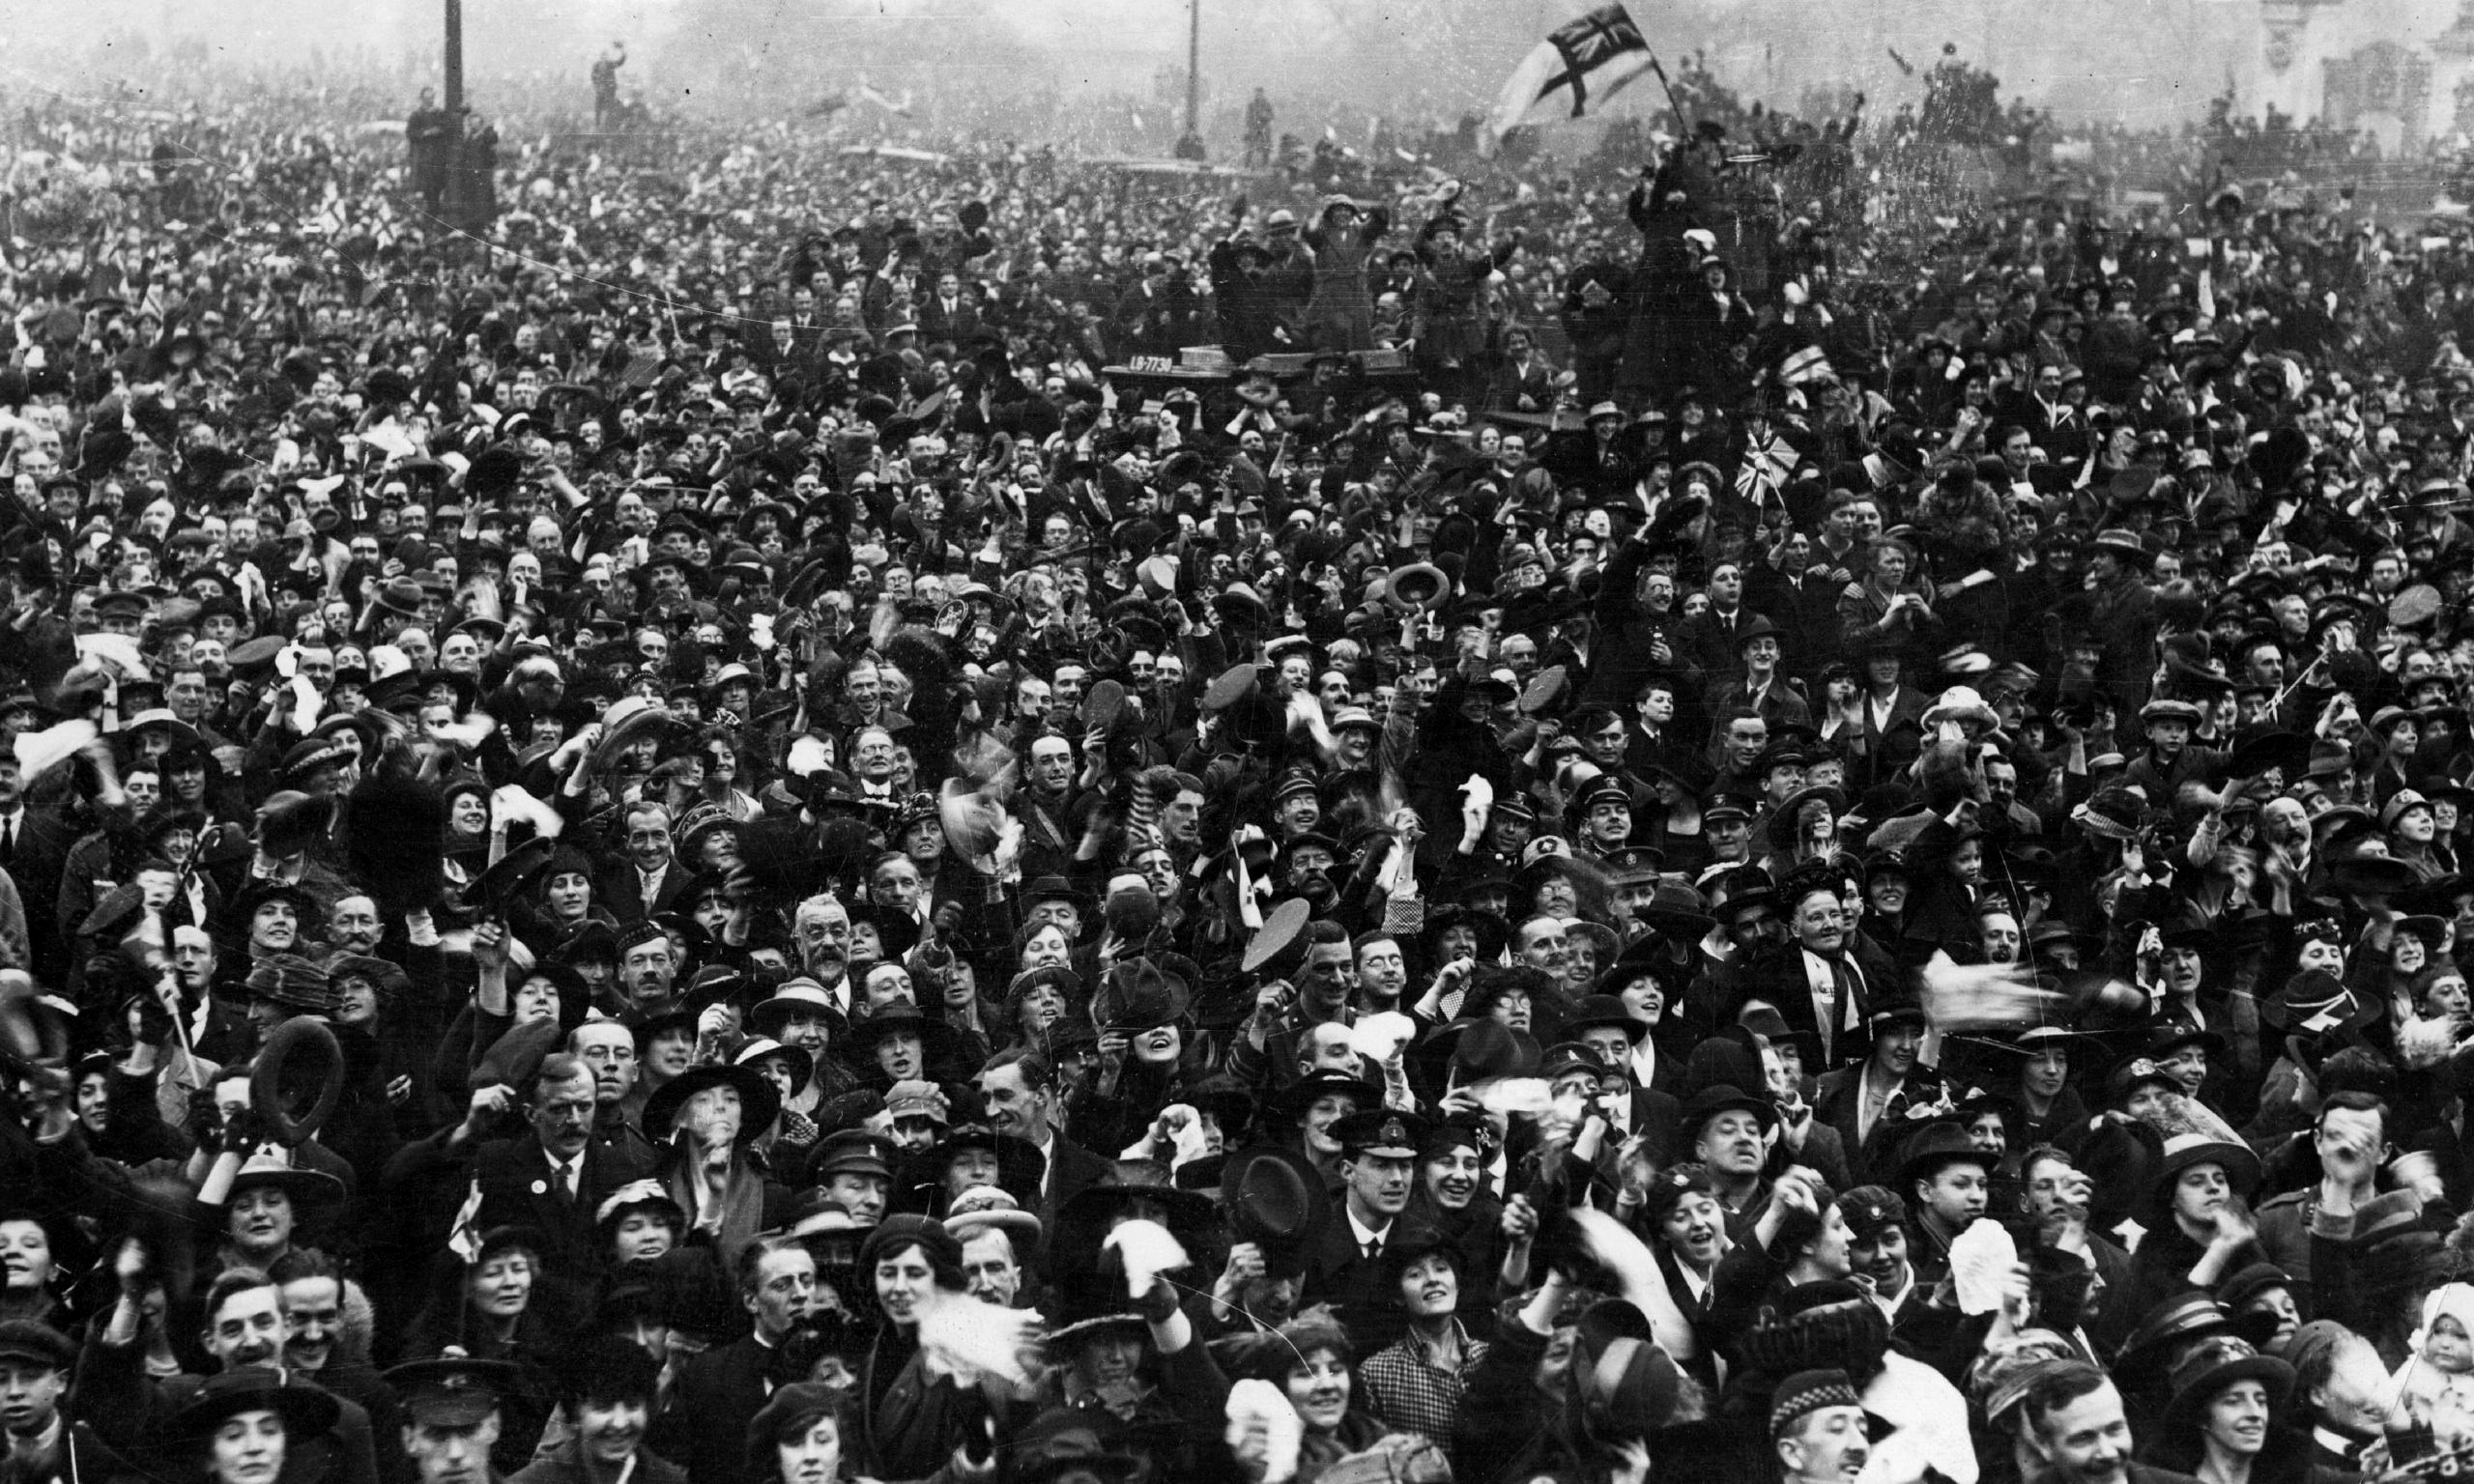
Armistice signed at 11 a.m. on 11th November 1918

Slide 69
Minute book 15th November 1918
A suggestion was brought forward that returning soldiers who were members prior to the war should be entertained and the cost of the same defrayed by levying all members, the suggestions was referred to the Branches.

Slide 70
Worse than the war 28th December 1918
Mr H. Patrick Devitte writes to the London Express from Geneva: “A Swizz doctor has collected statistics from all parts of the world proving that Spanish influenza killed more persons during the three months ending November 1918 than all the great battles combined. He calculates that 6,000,000 deaths occurred in the world from the disease in this short period, while he roughly estimates the loss of life during the first four and a half years of the war at 20,000,000.”
96,908 INFLUENZA DEATHS
It is recorded in the Registrar General’s weekly return that the number of deaths from influenza registered in England and Wales during the fourth quarter of 1918 was 96,908. The disease is still abating.

Slide 71
2nd June 1922 the Birmingham Advertiser
‘On the outbreak of war in 1914, no body of men answered the call of King and Country with greater enthusiasm, than the Birmingham tramways men. Before the end of August, 600 men, or 20% of the total employees of the department had joined up. So keen were the men to do their duty that on one memorable Sunday morning no fewer than 300 march en bloc to Witton Barracks, and enlisted in the 8th Warwickshire Regiment: these men formed a double company in that regiment and provided their own non-commissioned officers. Throughout the course of the War, the tramways department supplied 1,800 men to the forces.

Slide 72
In 1920 some 1300 ex-members of the Armed Forces were entertained at the Stadium Club. In October 1921 it was agreed that a Cenotaph be erected at the Transport Ground to honour the fallen and a committee was formed to oversee this. The date for the Dedication of the Cenotaph was set for 28th May 1922 with Lieutenant F Clarke MM unveiling the Memorial. The cost of the Cenotaph was paid for by the members of the different branches with a weekly levy of 1d a week.

Slide 73
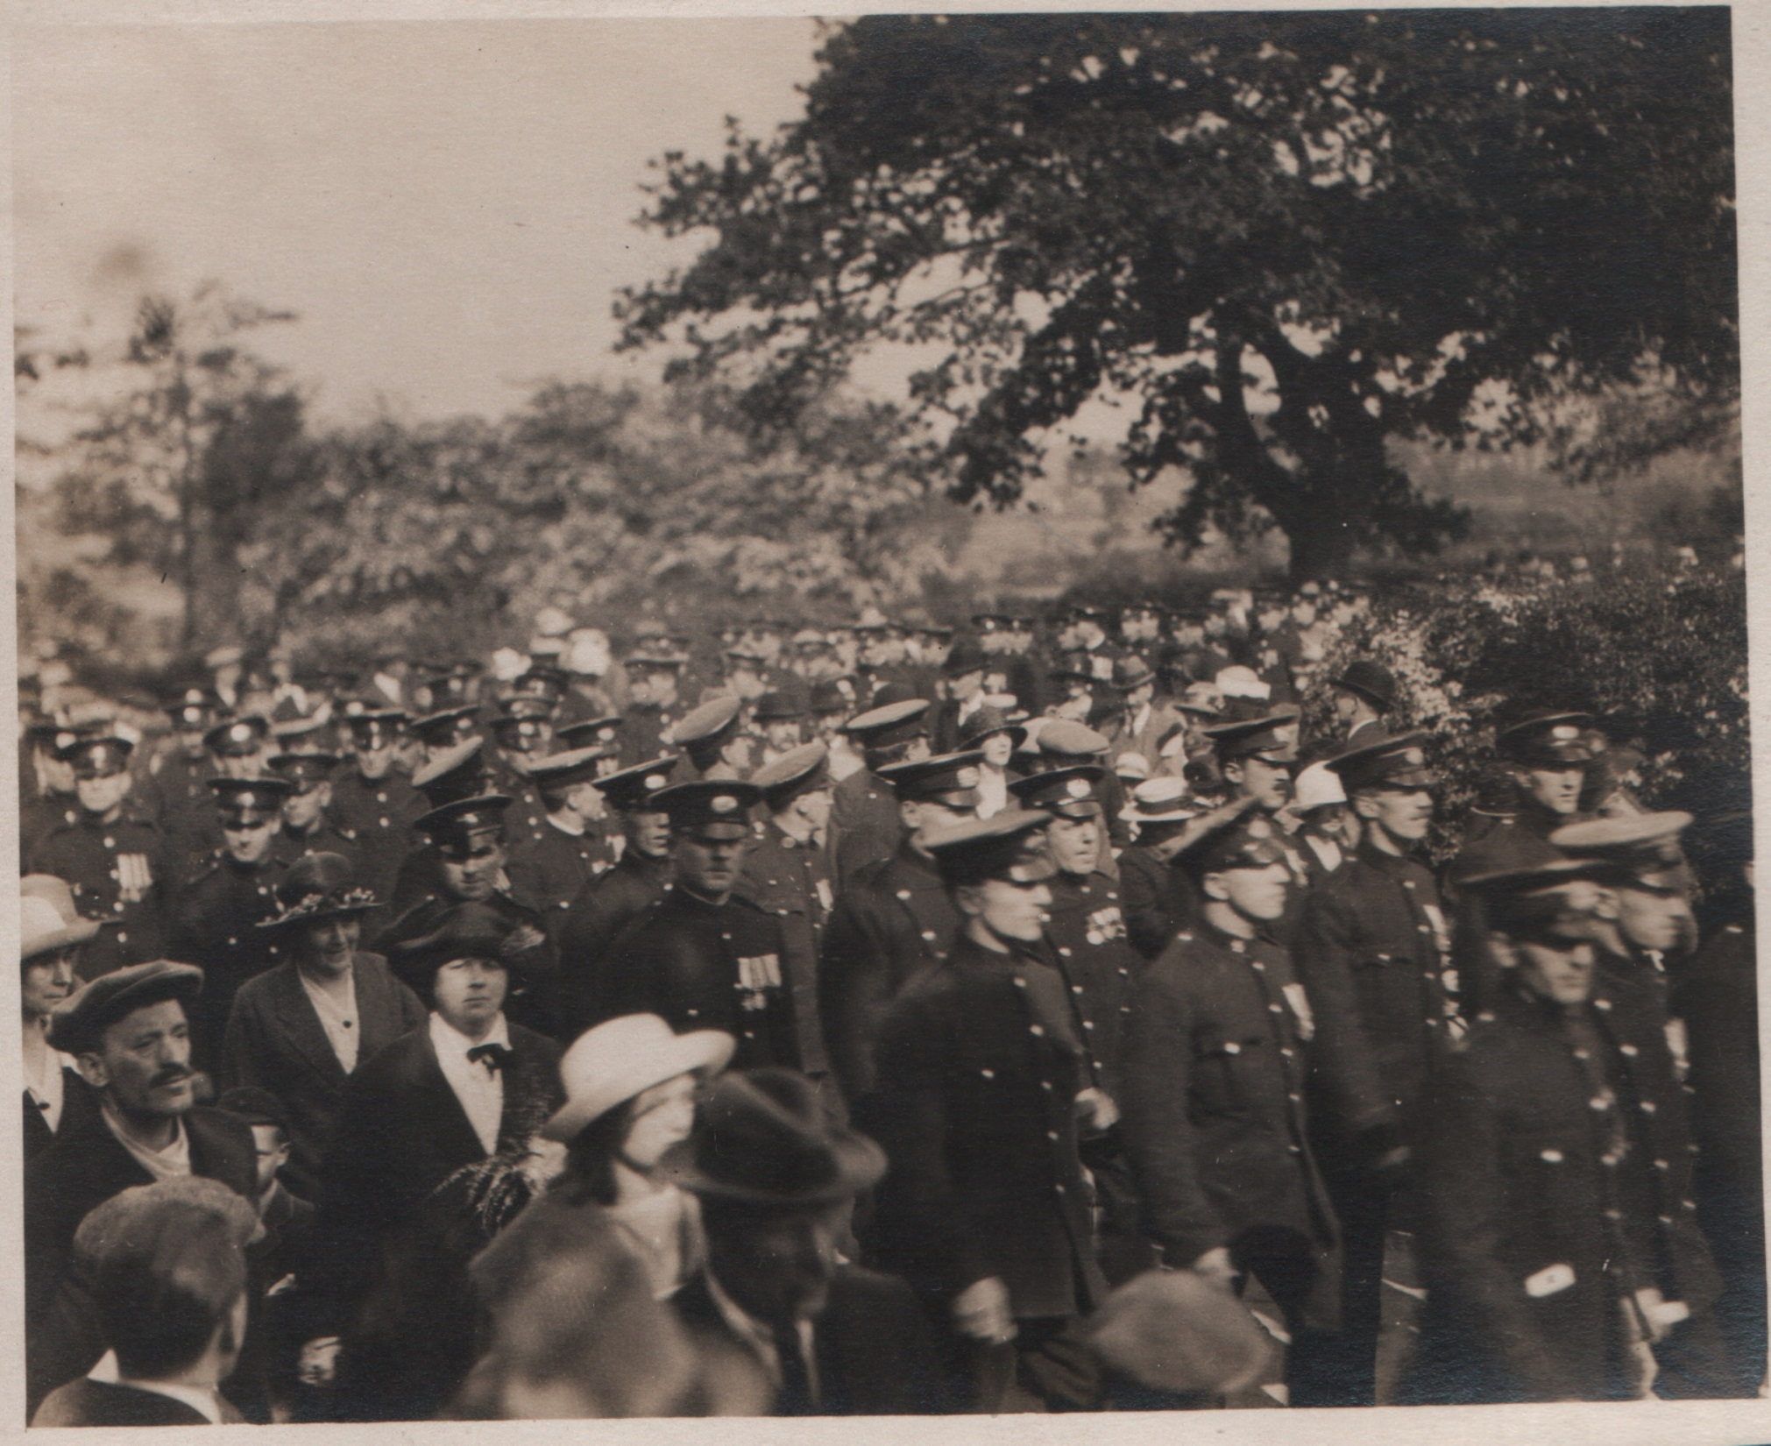

Slide 74
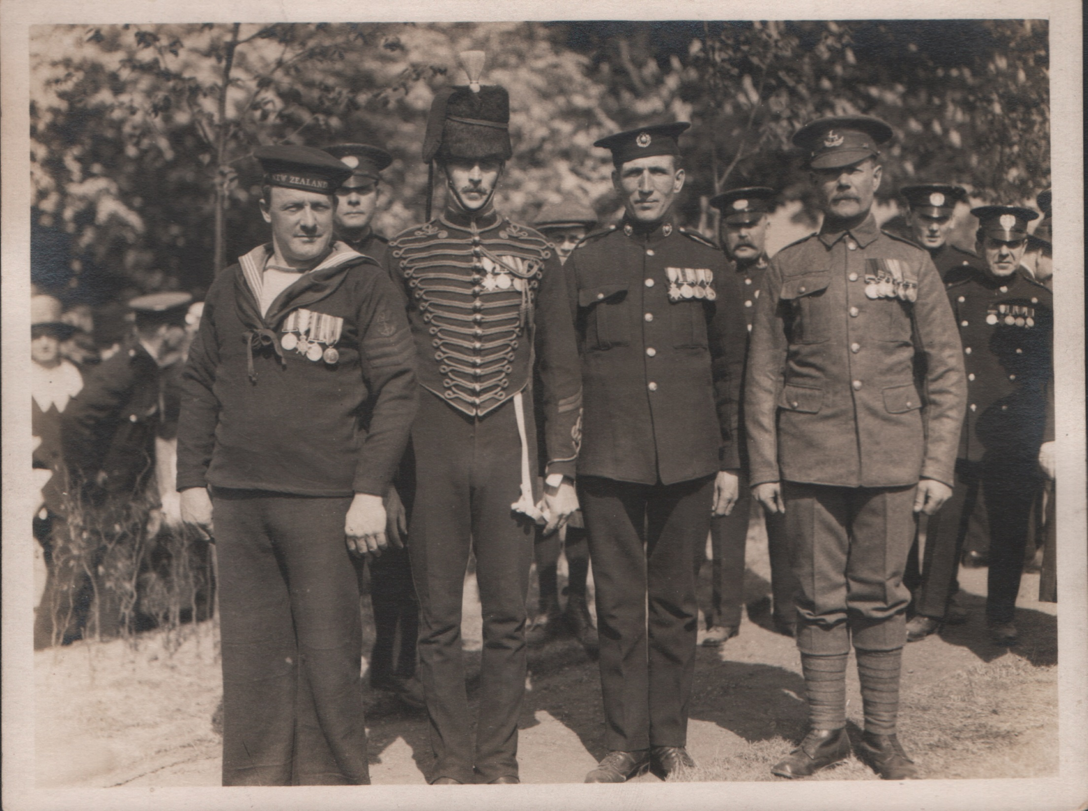

Slide 75
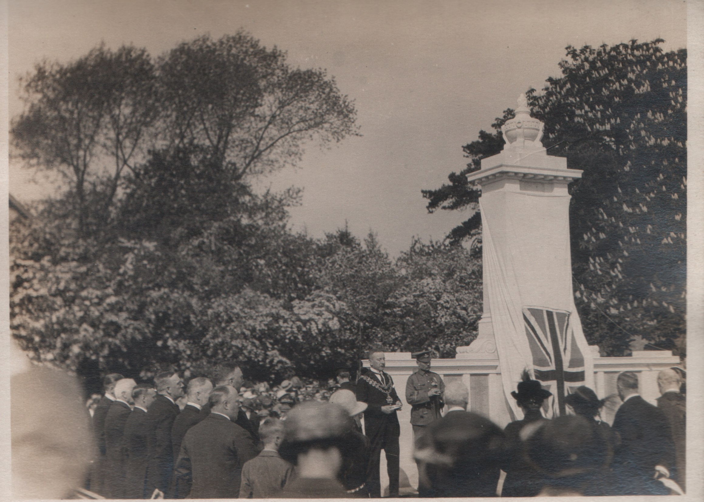

Slide 76
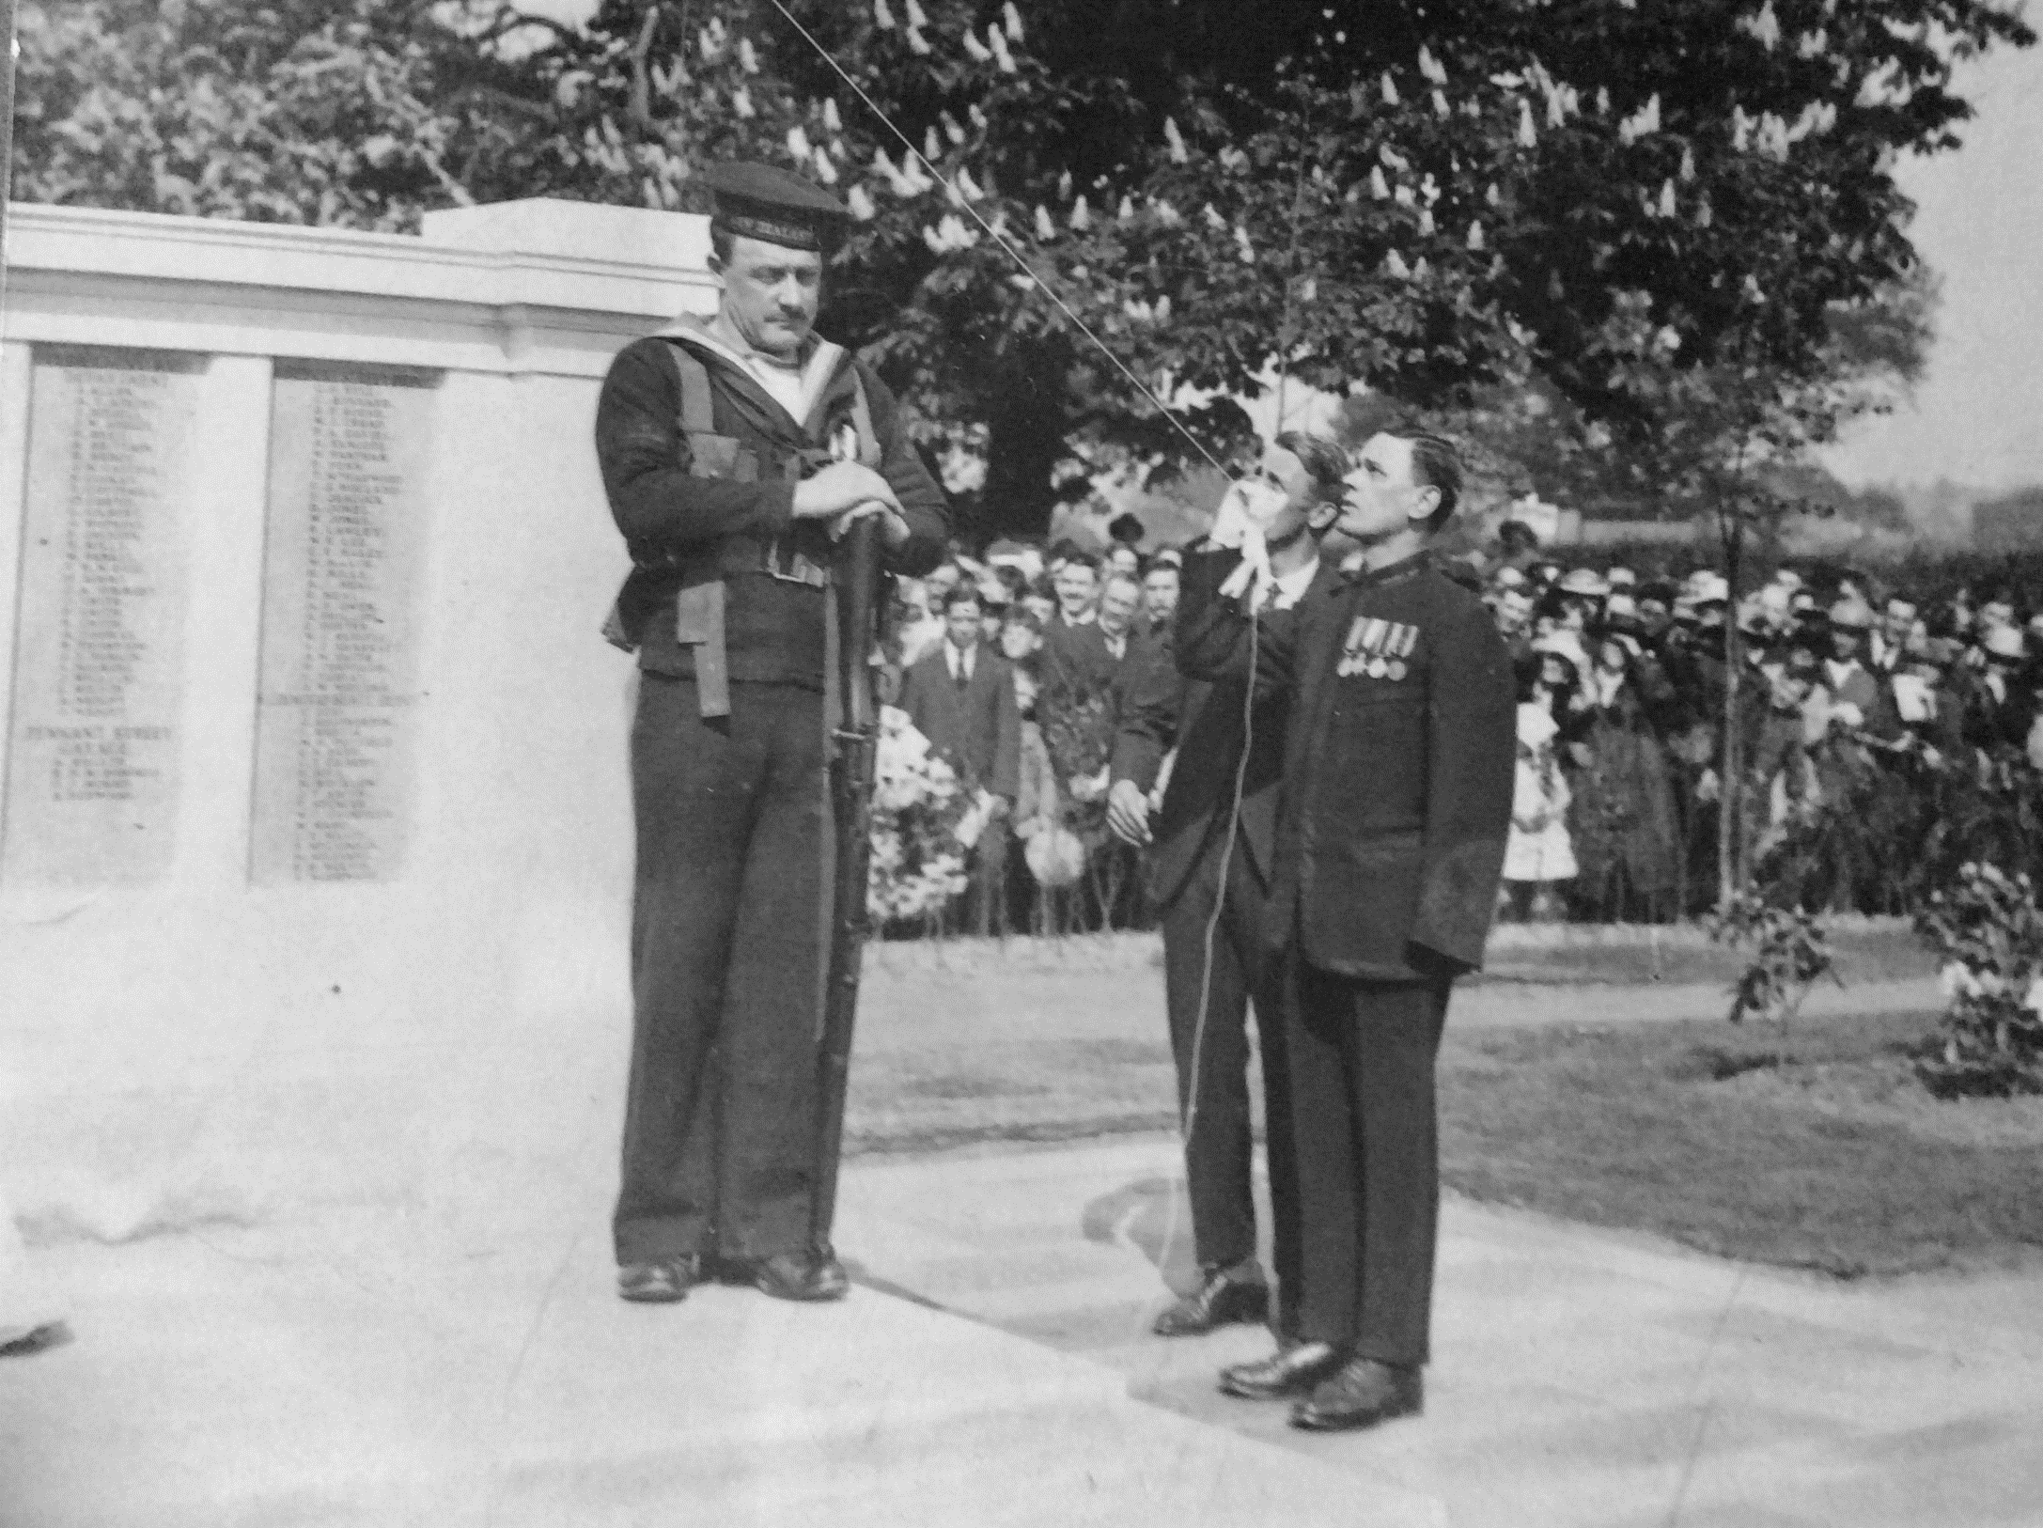
28th May 1922 with Lieutenant F Clarke MM unveiling the Memorial.

